Slide 1
Heart Failure Prediction

Slide 2
Outlines
01
02
03
04
05
06
Introduction
About This Project
About the Dataset
QUESTIONS
EDA
Modeling

Slide 3
Introduction
Cardiovascular diseases (CVDs) are not just a health condition; they represent a global burden, the leading cause of mortality that claims approximately 17.9 million lives annually accounting for 31% of deaths worldwide. The gravity of CVDs is not solely in the numbers but also in the narrative of each life, with a significant proportion of these tragedies striking prematurely in individuals under the age of 70. This project aims not just to interpret data but to extend lives, leveraging predictive analytics to combat the silent yet rampant march of heart disease.

Slide 4
About This Project
In this project, we delve deep into understanding the causes of heart disease and its correlations with health indicators. Through diverse data visualizations, we aim to uncover key patterns. We also employ statistical models to automate heart disease detection, with potential applications in early intervention within medical contexts. Our project combines statistical insights with real-world implementation, emphasizing a comprehensive approach to tackling heart disease.

Slide 5
About the Dataset
The [Heart Failure Prediction Dataset] dataset contains 1K rows and 12 columns. It is a cleaned, smaller. The data was created by combining different datasets already available independently but not combined before. In this dataset, 5 heart datasets are combined over 11 common features which makes it the largest heart disease dataset available so far for research purposes. The five datasets used for its curation are:

Slide 6
About the Dataset
Cleveland: 303 observations
Hungarian: 294 observations
Switzerland: 123 observations
Long Beach VA: 200 observations
Stalog (Heart) Data Set: 270 observations
Total: 1190 observations
Duplicated: 272 observations
Final dataset: 918 observations

Slide 7

QUESTIONS
General Questions
Demographic and Personal Questions
Health Characteristics
Exercise and Stress Analysis

Slide 8
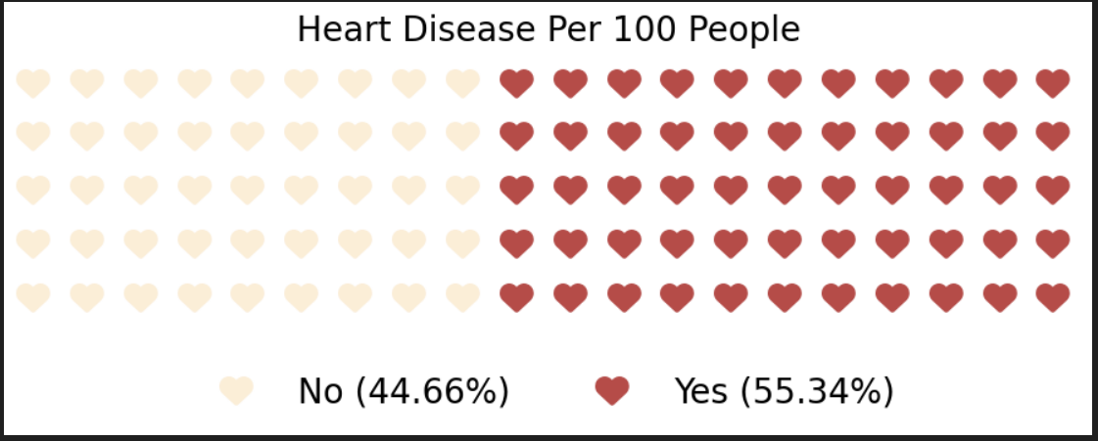
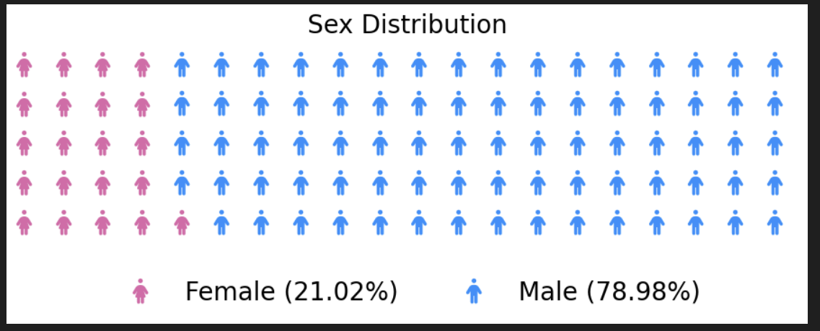
EDA

Slide 9
modeling
In logistic regression modeling, analysis is used to estimate the relationship between the outcome variable (in this case, the presence of heart disease) and other predictor variables (such as 'ChestPainType', 'Cholesterol', 'FastingBS', 'RestingECG', 'MaxHR', 'ExerciseAngina', 'Oldpeak', 'ST_Slope').

Slide 10
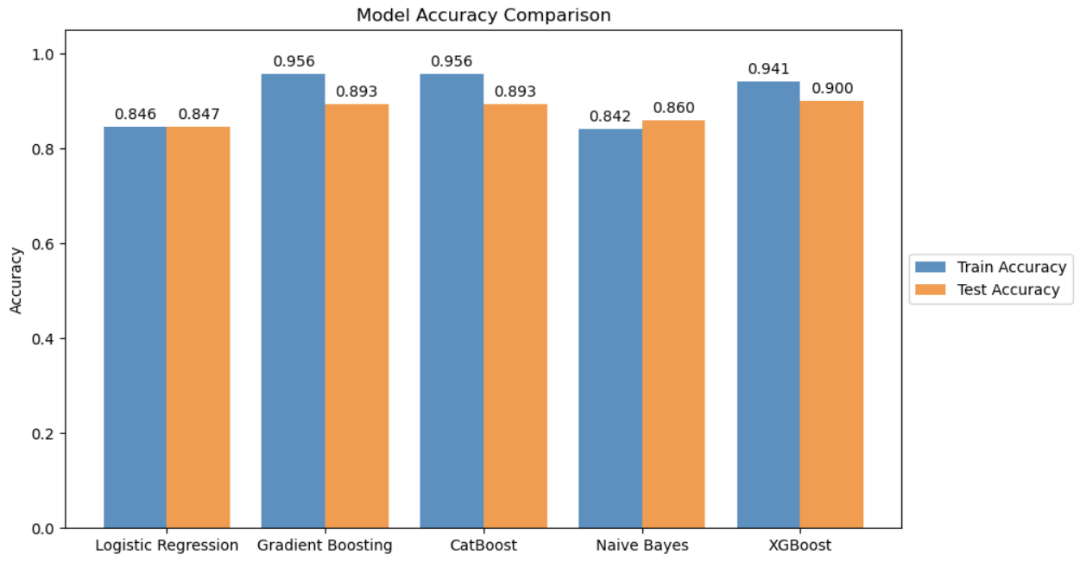
modeling

Slide 11

Thanks

